Slide 1
Introduction to Gear Trains U1C5

Slide 2
1.5.2 Introduction to Gear Trains
Overview:
The goal of this lesson is to give students some additional hands-on experience with the NXT kits parts and introduce the idea of gear trains (which is explored in more detail in the Getting in Gear lesson).
Objectives:
Students will be able to:
1. Describe how the relative size of the gears on a crank and a wheel in a gear train determine performance
2. Relate the gear train behavior to the example of a bicycle on a hill

Slide 3
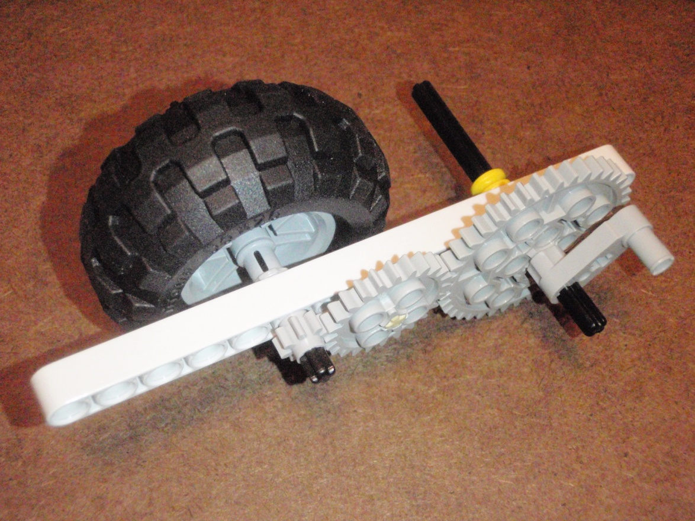
Crank-and-Wheel Assembly
Get these parts>>>>
1 15-hole beams
1 non-friction peg (yellow)
2 medium length axles
1 large wheel
1 handle/crank
3 different sized gears
2 gray spacers
And build according to picture:
Notes:
Build the following crank-and-wheel assembly
See Photo 1_2
Use medium length axle for first and last gears, non-friction peg for center gear
Attach any wheel to one axle, and crank (handle connector peg) to other axle
Have students turn handle/crank and observe wheel
Switch location of crank and wheel and repeat observation
Discuss with students how this relates to their experiences with bicycle gears (size of front and rear gears when going uphill vs downhill)
When going downhill student pedals (cranks) on large gear with small gear on wheel (maximizing speed)
When going uphill student pedals (cranks) on small gear with large gear on wheel (maximizing torque/power)
We will revisit the speed vs torque tradeoff later in the future Getting in Gear lesson
Have students set the wheel on a table and turn the crank 3 times in both configurations:
Ask students what determines how far the assembly moves:
Number of rotations of the wheel
The circumference of the wheel
This is foreshadowing for the future How Far lesson
Note in the "downhill" configuration how much further the assemble travels
Greater distance = greater speed (in the same period of time)
This can also be looked at from an energy conversion perspective:
Rider inputs energy by pedaling:
In one case, the energy converts into more kinetic energy (speed)
In the other, the energy converts into lifting the bike/rider up the hill (increasing potential energy)

Slide 4
Crank-and-Wheel Assembly
Notes:
Build the following crank-and-wheel assembly
See Photo 1_2
Use medium length axle for first and last gears, non-friction peg for center gear
Attach any wheel to one axle, and crank (handle connector peg) to other axle
Have students turn handle/crank and observe wheel
Switch location of crank and wheel and repeat observation
Discuss with students how this relates to their experiences with bicycle gears (size of front and rear gears when going uphill vs downhill)
When going downhill student pedals (cranks) on large gear with small gear on wheel (maximizing speed)
When going uphill student pedals (cranks) on small gear with large gear on wheel (maximizing torque/power)
We will revisit the speed vs torque tradeoff later in the future Getting in Gear lesson
Have students set the wheel on a table and turn the crank 3 times in both configurations:
Ask students what determines how far the assembly moves:
Number of rotations of the wheel
The circumference of the wheel
This is foreshadowing for the future How Far lesson
Note in the "downhill" configuration how much further the assemble travels
Greater distance = greater speed (in the same period of time)
This can also be looked at from an energy conversion perspective:
Rider inputs energy by pedaling:
In one case, the energy converts into more kinetic energy (speed)
In the other, the energy converts into lifting the bike/rider up the hill (increasing potential energy)

Slide 5
Crank-and-Wheel Assembly
Turn handle/crank and observe wheel
Switch location of crank and wheel and repeat observation
How does this relate to your experiences with bicycle gears (size of front and rear gears when going uphill vs. downhill)
When going downhill student pedals (cranks) on large gear with small gear on wheel (maximizing speed)
When going uphill student pedals (cranks) on small gear with large gear on wheel (maximizing torque/power)
(We will revisit the speed vs. torque tradeoff later in the future Getting in Gear lesson)
Notes:
Have students turn handle/crank and observe wheel
Switch location of crank and wheel and repeat observation
Discuss with students how this relates to their experiences with bicycle gears (size of front and rear gears when going uphill vs downhill)
When going downhill student pedals (cranks) on large gear with small gear on wheel (maximizing speed)
When going uphill student pedals (cranks) on small gear with large gear on wheel (maximizing torque/power)
We will revisit the speed vs torque tradeoff later in the future Getting in Gear lesson
Have students set the wheel on a table and turn the crank 3 times in both configurations:
Ask students what determines how far the assembly moves:
Number of rotations of the wheel
The circumference of the wheel
This is foreshadowing for the future How Far lesson
Note in the "downhill" configuration how much further the assemble travels
Greater distance = greater speed (in the same period of time)
This can also be looked at from an energy conversion perspective:
Rider inputs energy by pedaling:
In one case, the energy converts into more kinetic energy (speed)
In the other, the energy converts into lifting the bike/rider up the hill (increasing potential energy)

Slide 6
Crank-and-Wheel Assembly
Set the wheel on a table and turn the crank 3 times in both configurations:
Turn handle/crank and observe wheel
Switch location of crank and wheel and repeat observation
What determines how far the assembly moves?
Number of rotations of the wheel
The circumference of the wheel
(This is foreshadowing for the future How Far lesson)
Notes:
Have students set the wheel on a table and turn the crank 3 times in both configurations:
Ask students what determines how far the assembly moves:
Number of rotations of the wheel
The circumference of the wheel
This is foreshadowing for the future How Far lesson
Note in the "downhill" configuration how much further the assemble travels
Greater distance = greater speed (in the same period of time)
This can also be looked at from an energy conversion perspective:
Rider inputs energy by pedaling:
In one case, the energy converts into more kinetic energy (speed)
In the other, the energy converts into lifting the bike/rider up the hill (increasing potential energy)

Slide 7
Crank-and-Wheel Assembly
Note in the "downhill" configuration how much further the assemble travels
Greater distance = greater speed (in the same period of time)
This can also be looked at from an energy conversion perspective:
Rider inputs energy by pedaling:
In one case, the energy converts into more kinetic energy (speed)
In the other, the energy converts into lifting the bike/rider up the hill (increasing potential energy)
Notes:
Note in the "downhill" configuration how much further the assemble travels
Greater distance = greater speed (in the same period of time)
This can also be looked at from an energy conversion perspective:
Rider inputs energy by pedaling:
In one case, the energy converts into more kinetic energy (speed)
In the other, the energy converts into lifting the bike/rider up the hill (increasing potential energy)

Slide 9
NXT Parts Exploration
CMU Technical Primer Flash – Construction Techniques
http://stemrobotics.cs.pdx.edu/sites/default/files/technicprimer.swf
CubeStormer II "The Ultimate Cube Solver” (3:08)
http://www.youtube.com/watch?feature=player_detailpage&v=qTq2V1aPAp8
Lego Mindstorms Robots (5:20) http://www.youtube.com/watch?feature=player_detailpage&v=_lbp0ueqHFs
LEGO NXT Balancing Road TwoWheels Robot (4:37)
http://www.youtube.com/watch?feature=player_detailpage&v=-KQcUo3JVUs
Sudoku Solver (4:06)
http://www.youtube.com/watch?v=Mp8Y2yjV4fU
Portrayer (1:42)
http://www.youtube.com/watch?v=_ogQuLdEcBY&feature=player_embedded
Notes:
Instructional Material: CMU Technical Primer Flash

